Slide 1
Social Media and Data Aggregation
Threats and Vulnerabilities
Counterintelligence

Slide 2
Social Media

Slide 3
Business Intelligence/Industrial Espionage
Business Intelligence
Business activity used to gather Open Source Intelligence (OSINT) in order to inform business decisions
Industrial Espionage
Active efforts engaged in order to obtain trade secrets, classified/controlled unclassified, or proprietary information
Notes:
https://www.investopedia.com/what-is-tiktok-4588933

Slide 4
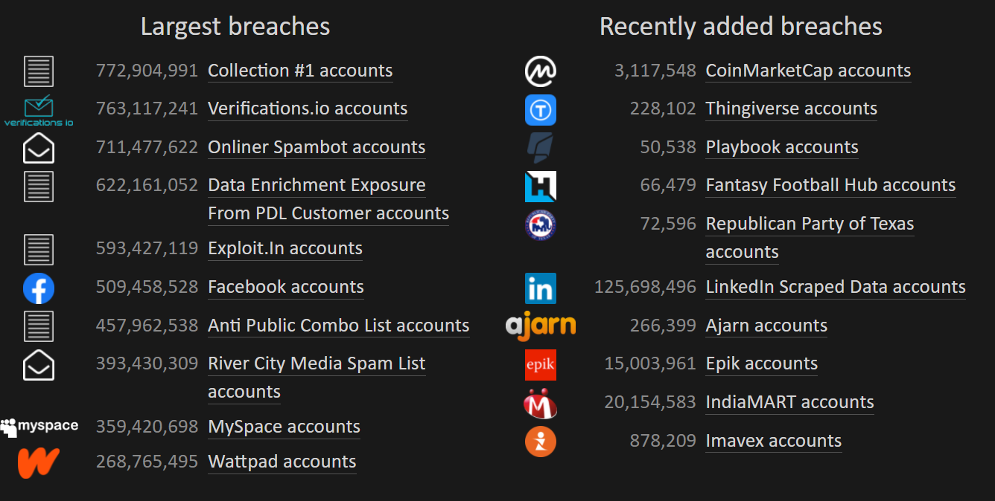
Data Breaches
Provide valuable details for industrial espionage/business intelligence
Enable social engineering to better craft ransomware, phishing, spear-phishing attacks
Notes:
https://www.identityforce.com/blog/2021-data-breaches

Slide 5
LinkedIn
Premiere job-hunting and networking website
The world's largest professional network with 706+ million users in more than 200 countries and territories worldwide
Notes:
https://about.linkedin.com/

Slide 6
What Information is Collected?
Any data from apps you have ‘linked’ with your LinkedIn Profile
Automatically links profile to search engines
Potentially creates an indexed/cached version of your data
Aggregates your data with other Microsoft owned apps/platforms
Unless you change your setting, this collected as well:
Interest categories
Connections
Location
Demographics
Groups
Education
Job Information
Interaction with Businesses
Websites visited through linkedin
Companies you follow
Employer
Notes:
https://about.linkedin.com/

Slide 7
Evidence of FIE on LinkedIn
Kevin Patrick Mallory
Jun Wei Yeo
Notes:
https://about.linkedin.com/

Slide 8
Evidence of FIE on LinkedIn
Kevin Patrick Mallory
Former CIA Officer
Retired and had no work
$200,000+ in debt
Received LinkedIn Request from Chinese Profile
Began working with the Ministry of State Security
Caught by the FBI and sentenced to Prison
Notes:
https://about.linkedin.com/

Slide 9
Jun Wei Yeo
Pled guilty to acting within the US as an illegal agent of a foreign power
Admitted to the following:
Establishing fake consulting firm
Posted Job advertisements
90% of the resumes:
Military
Government Employees
Passed resumes of note to Chinese Intelligence Operatives

Slide 10
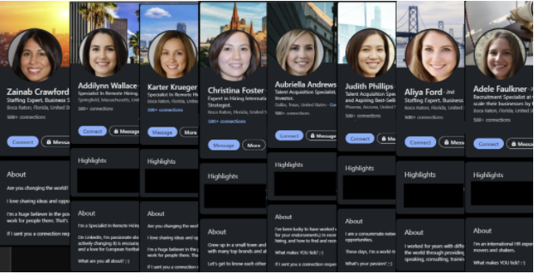
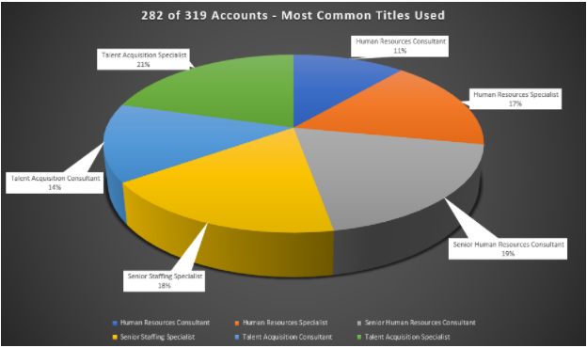
Hatless1der’s Findings
OSINT Professional identified the following:
Common job titles: Talent Acquisition, Human Resources Specialist/Supervisor/Admin etc,
Captured over 300 profiles sharing the same series of unique bios
Used Generated Adversarial Network images to make the profile photos untraceable
Notes:
https://hatless1der.com/linkedin-fakes-a-wolf-in-business-casual-clothing/

Slide 11
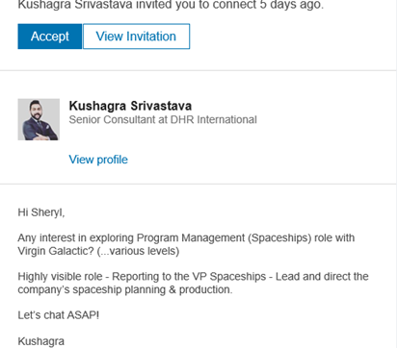
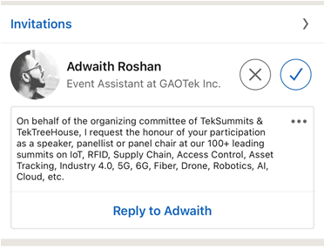
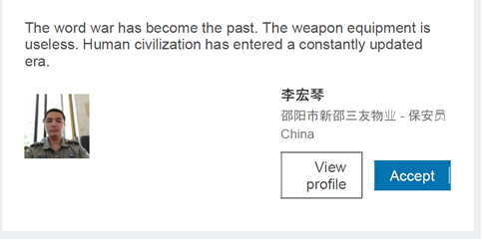
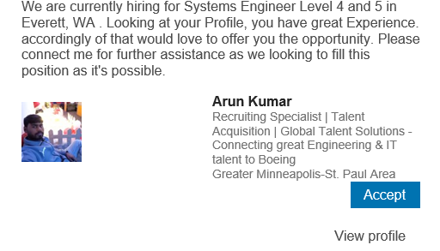
Targeting
REPORT Connection requests/messages from:
Foreign nationals
Headhunters
Fake Personnel
Suspect businesses
About Conferences, Conventions, and Tradeshows
Notes:
https://www.newsweek.com/russia-putin-bots-linkedin-facebook-trump-clinton-kremlin-critics-poison-war-645696

Slide 12
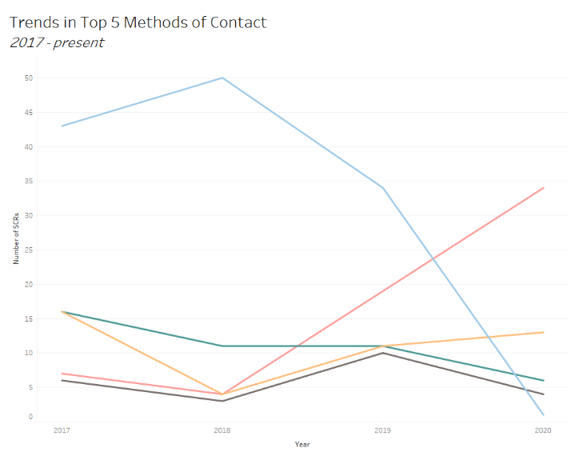
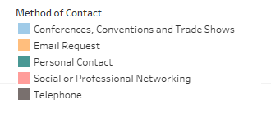
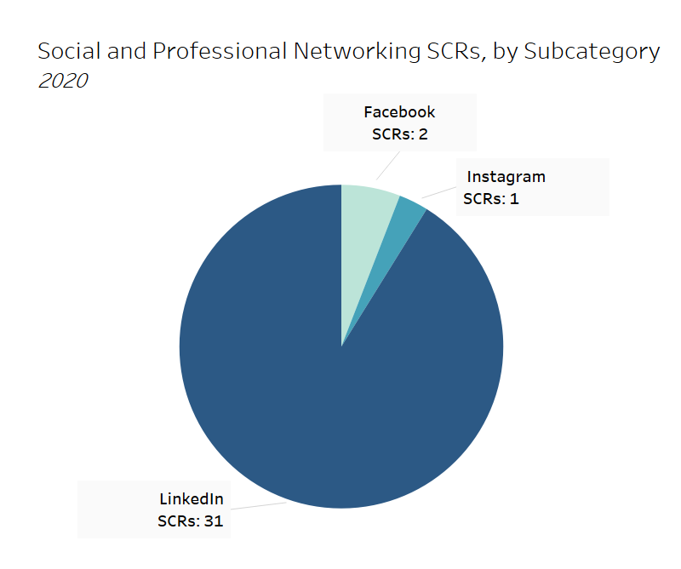
LinkedIn: An Emerging Threat
In past years, Conferences, Conventions and Tradeshows (CCTs) has been the most common method of contact
The SCRs where the Method of Contact was CCTs decreased drastically in 2020, while SCRs with the Method of Contact Social or Professional Networking and Email Requests both increased
What’s the Risk? Reporting on cyber threats in 2020 found that due to the COVID-19 pandemic, there was an increase in malicious cyber activity, including phishing incidents, email attacks and social networking attacks. The vast majority of Social and Professional Networking SCRs involved LinkedIn, showing that employees are increasingly being targeted online.

Slide 13
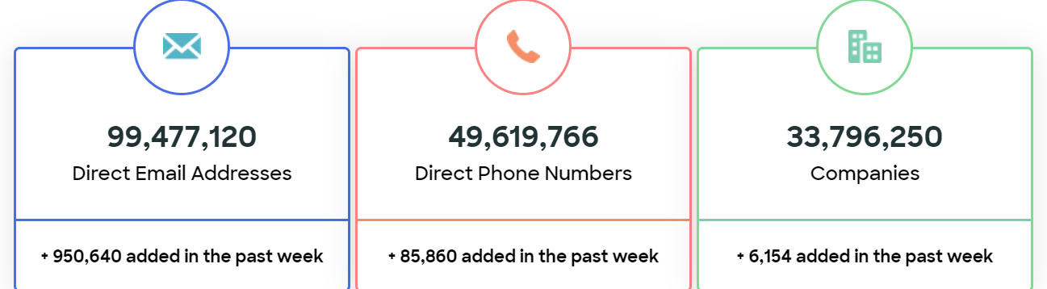
Not on LinkedIn? Why should it matter?
Archives
Waybackmachine
Screenshots
Have you heard of zoominfo?
A business intelligence company that uses artificial intelligence paired with the former Israeli company chorus.ai in order to scrape accurate details from millions of sources on the web

Slide 14
Data Aggregation and Brokers
What are they?
Companies that collect information from public records, online activity, social media, and purchase history and re-sell it to other companies or individuals
Approximately 4K worldwide
Examples:
Acxiom, Spokeo, Mylife, Intelius, whitepages, etc.
Examples:
TowerD@ta
Allegedly has 80% of US email addresses on file
CampaignGRID and ProPublica
Political info, party affiliation, contributions for 80% of registered voters
Spokeo
Social Media search function
Notes:
https://www.fastcompany.com/90310803/here-are-the-data-brokers-quietly-buying-and-selling-your-personal-information

Slide 15
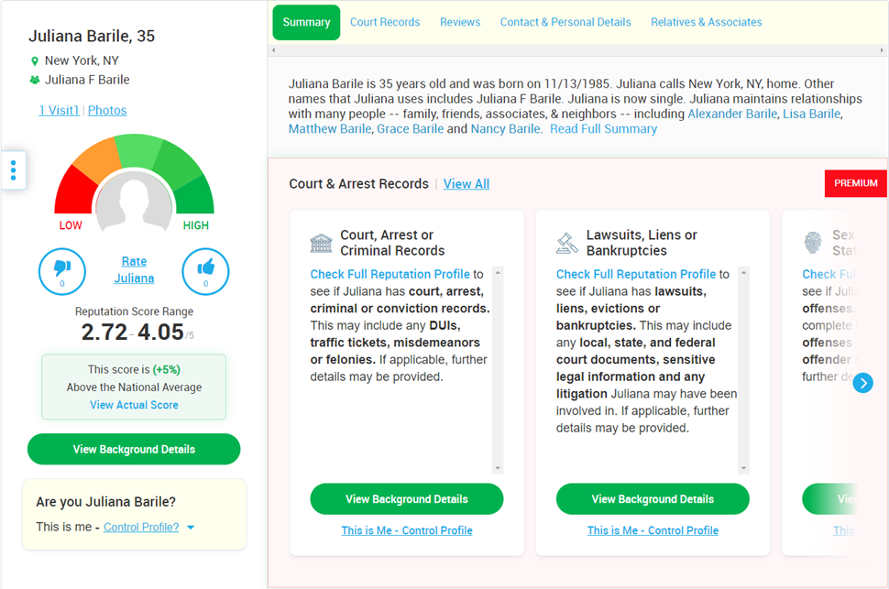
Data Aggregation
Conglomerated from:
Voter rolls
Property records
Purchase histories
Loyalty card programs
Car dealership records
Consumer surveys
Facebook
LinkedIn
Public/government records
Sometimes lacks accuracy
Notes:
https://duo.com/decipher/data-brokers-social-media-user-privacy

Slide 16
Purpose
These sites have legitimate purposes:
Help landlords review tenants
Law enforcement purposes
Credit ratings
Who has access to these sites?
Anyone willing to pay:
Individuals
Companies
Governments

Slide 17
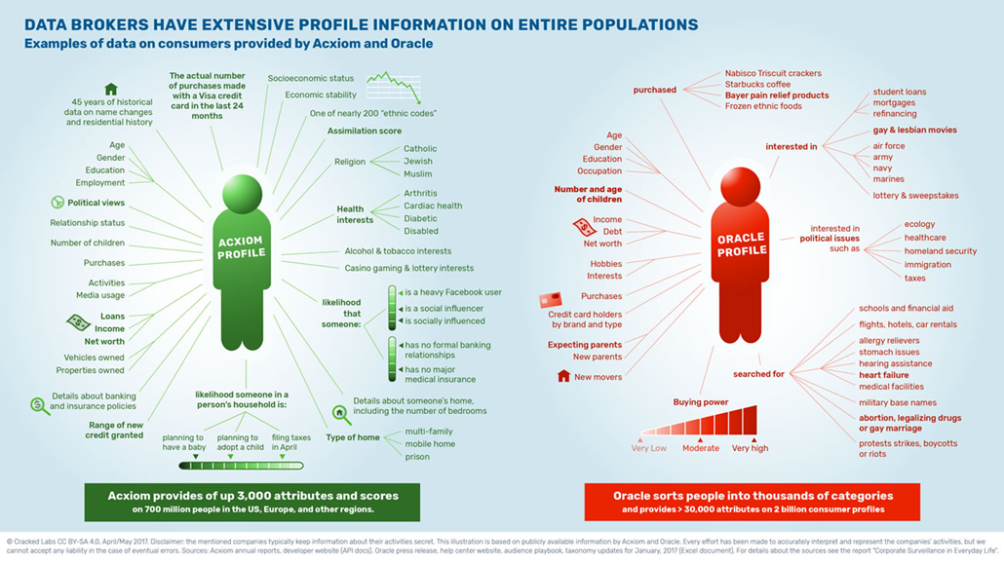
Examples: Acxiom and Oracle
Notes:
https://www.fastcompany.com/90310803/here-are-the-data-brokers-quietly-buying-and-selling-your-personal-information

Slide 18
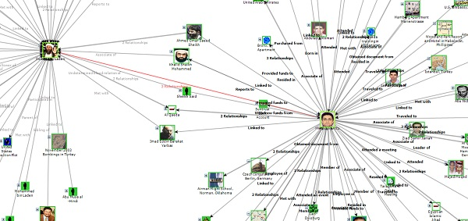
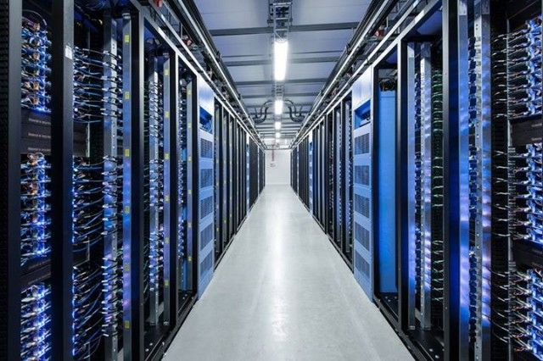
Acxiom
Acxiom one of many data brokerage websites
Publicly available information
Gathered without consent
23k servers collecting and analyzing info
Data for 500 million individuals
3000 data points per person
Notes:
https://github.com/glamrock/data-brokers/blob/master/data-brokers.md
https://www.vice.com/en_us/article/ne9b3z/how-to-get-off-data-broker-and-people-search-sites-pipl-spokeo
https://www.ftc.gov/system/files/documents/reports/data-brokers-call-transparency-accountability-report-federal-trade-commission-may-2014/140527databrokerreport.pdf

Slide 19
Surveillance Capitalism
An economic system centered around the commodification of personal data with a core purpose of making profit
Theoretically, helps ‘business intelligence’ by creating better products, hold inventory, and serve customers opening up a world of ‘endless convenience’.
How it works:
Granular data gathering (see Oracle in previous slides)
Essentially dispossessing people of their personal info
Emotional Volatility
Ease of access
Commodification of personal experiences
Harvard Professor Shoshana Zuboff
Notes:
https://www.makeuseof.com/what-is-surveillance-capitalism/
The Age of Surveillance Capitalism: The Fight for a Human Future at the New Frontier of Power-Shoshana Zuboff
https://fee.org/articles/what-is-surveillance-capitalism-and-should-we-be-concerned/

Slide 20
What Can I Do?
The Fair Credit Reporting Act
Requires companies to delete information if requested
If you request an opt-out, they will exclude your information
Opt-out requirements vary from service to service
Email
ID
Create a burner email account for this
Use the 2019 Smartbook on Social Media and Data Aggregation Websites
Information on all social media and myriad data brokers

Slide 21
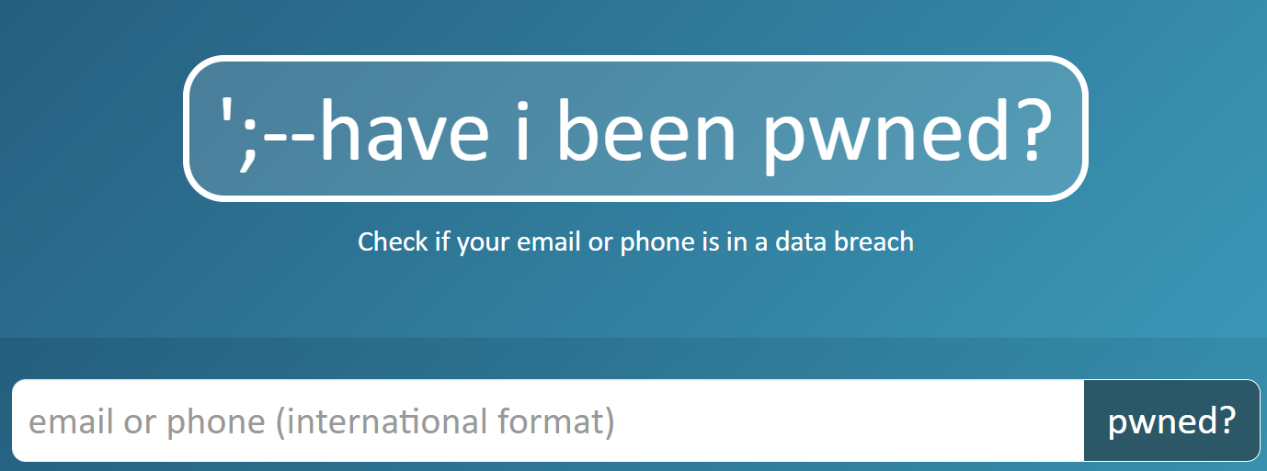
Online Tools
Privatize EVERYTHING
haveibeenpwned.com
Search yourself and details online
ONLY AFTER you change your
browser session each time and vpn
each time
Online Data Removal Workbook
https://inteltechniques.com/workbook.html

Slide 22
Parting Thoughts
“The Surveillance is permanent in its effects, even if it is discontinuous in its action; …the perfection of power should tend to render its actual exercise unnecessary.”
-Michel Foucalt
“He who is subjected to a field of visibility, and who knows it, assumes responsibility for the constraints of power; he makes them play spontaneously upon himself; he inscribes in himself the power relation in which he simultaneously plays both roles; he becomes the principles of his own subjection.”
-Michel Foucalt

